Slide 1
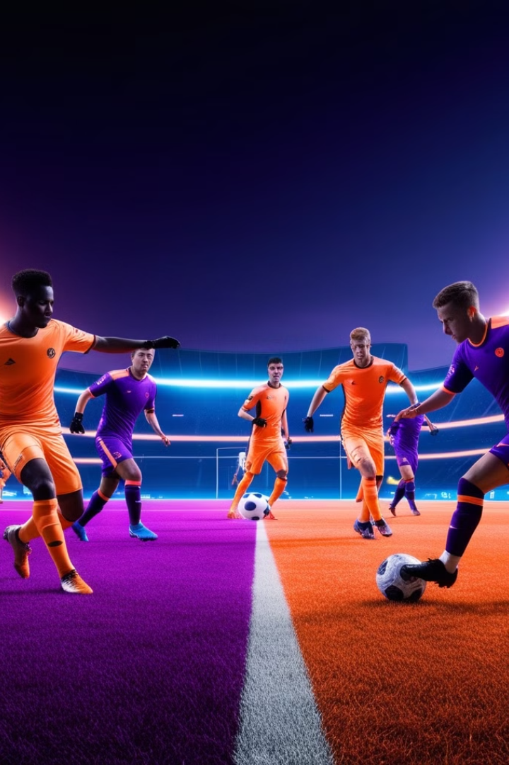
GoalMetrics: Revolutionizing Football Analytics

Slide 2


Meet the Team
Afnan Mubashir
Taqi Zameer
SP22-BDS-004
SP22-BDS-035
Supervisor: Mr. Osama Subhani
Co-Supervisor: Ms. Sanam Aamir

Slide 3

What is SoccerLytics?
SoccerLytics is an integrated platform that provides advanced football analytics, empowering teams, coaches, and fans to gain unprecedented insights into player and team performance.

Slide 4
Filling a Critical Gap
The Problem
The Solution
Existing analytical tools lack comprehensive player and team insights, limiting the ability of coaches and managers to make data-driven decisions.
It offers an integrated platform that delivers advanced analytics, enabling users to uncover hidden insights and optimize their performance.

Slide 5
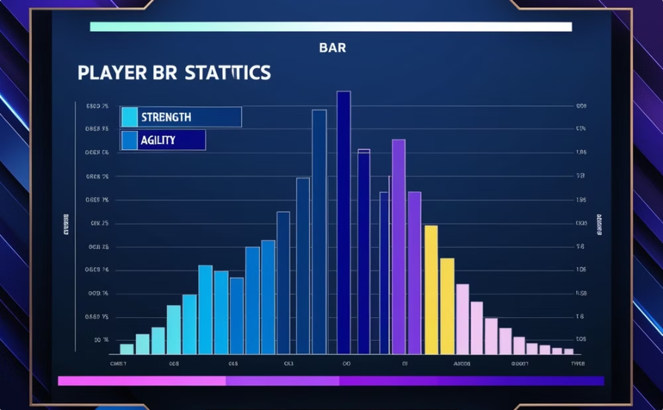
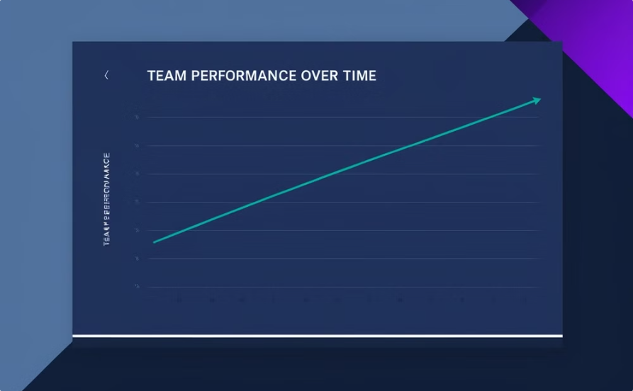
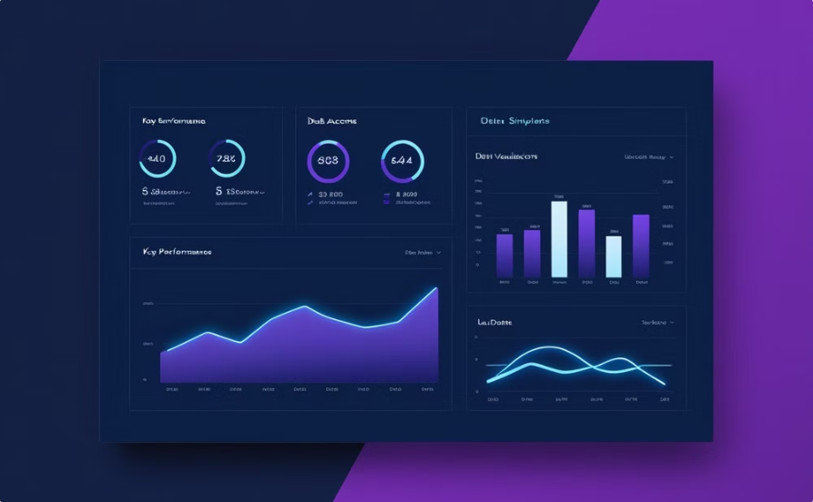
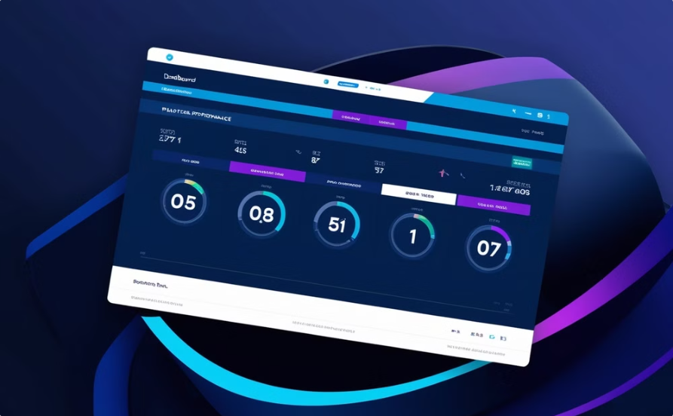
Unlocking the Power of Analytics
Player Insights & Comparisons
Team Insights and Comparison
Detailed player profiles and advanced statistical analysis to identify strengths,
weaknesses, and potential development areas.
Comprehensive team performance metrics and benchmarking to optimize
strategies and tactics.
Player Performance Dashboards
Team Performance Dashboards
Interactive visualizations showcasing individual player statistics, providing visualized metrics like passing accuracy, shot conversion rates, and defensive actions for easy analysis.
Visualizations focused on team performance, featuring metrics such as match outcomes, goal differentials, and trends over time to assist in strategic decision-making

Slide 6
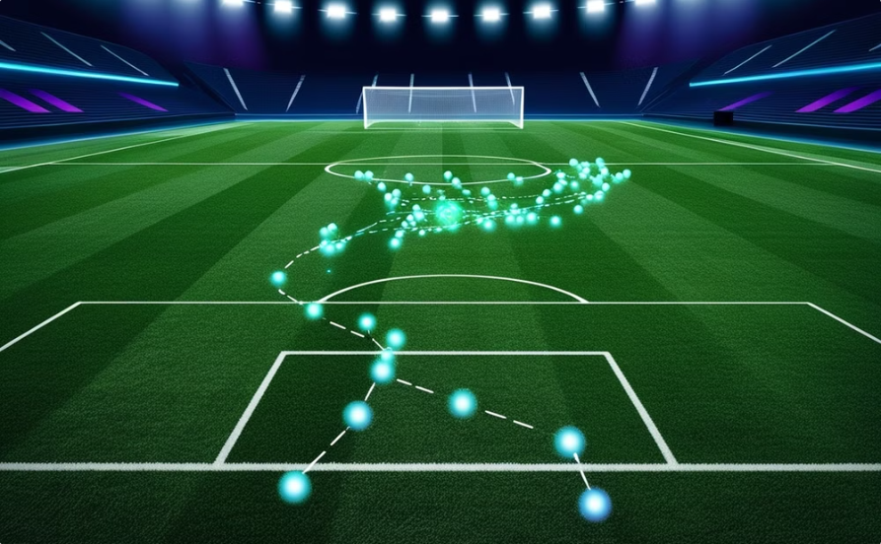
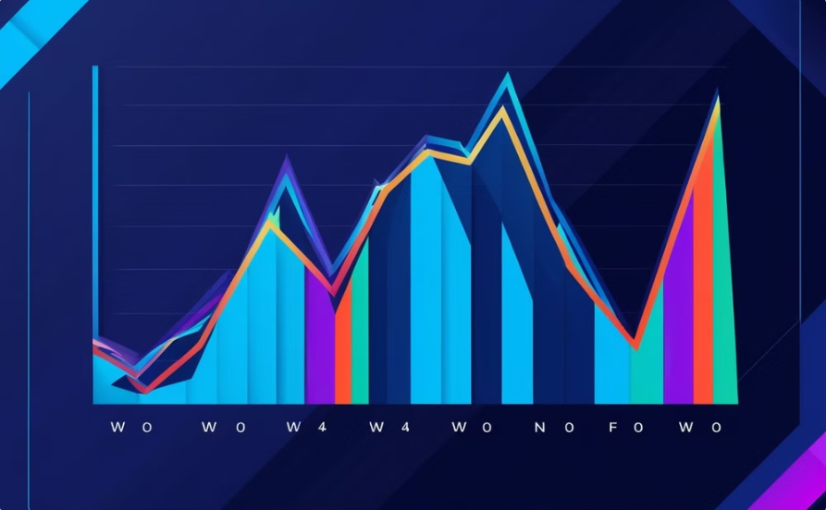
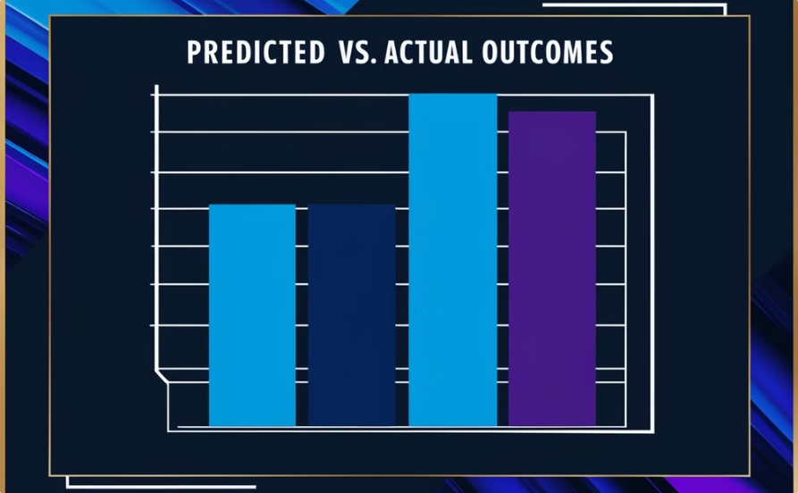
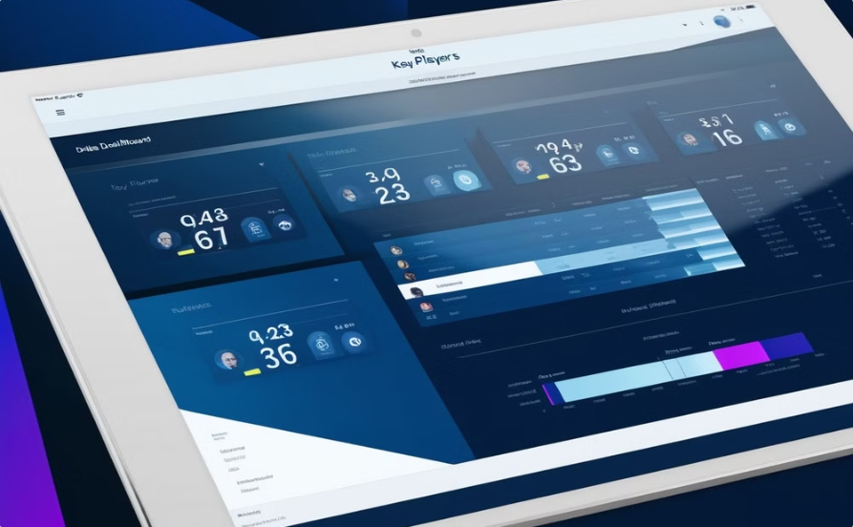
Unlocking the Power of Analytics
Detecting Player Movements
Intelligent Chatbot
Detect and analyze player movement patterns to uncover tactical insight
Provide personalized support and answer user queries
Match Outcome Prediction
Advanced Player Analytics
Advanced machine learning models to predict match outcome between
any two different teams
Unlock deeper insights into player performance and playing behavior.

Slide 7
ANY QUESTIONS?
THANK YOU SO MUCH!

